Slide 1
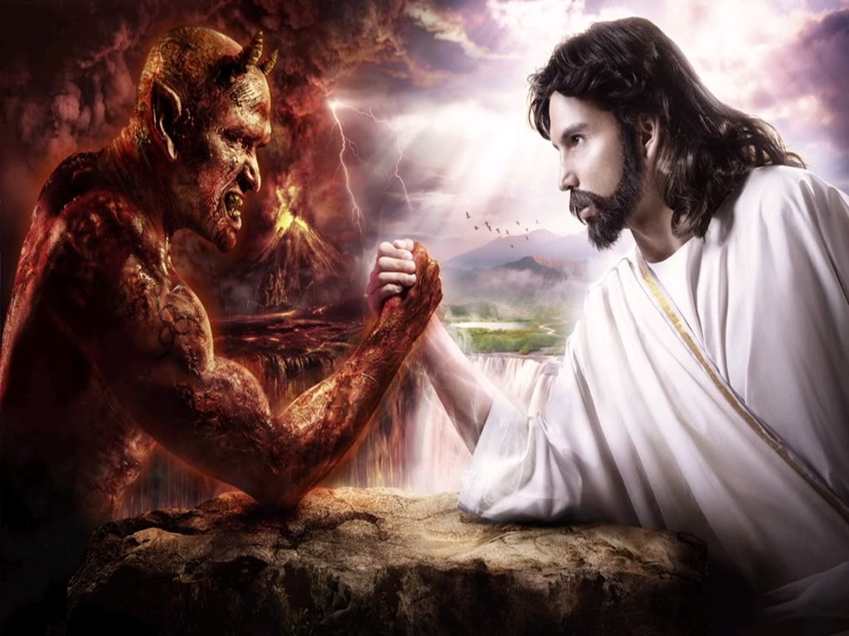

The Marriage of Heaven and Hell
(The Marriage of Studies and Social life)

Slide 2
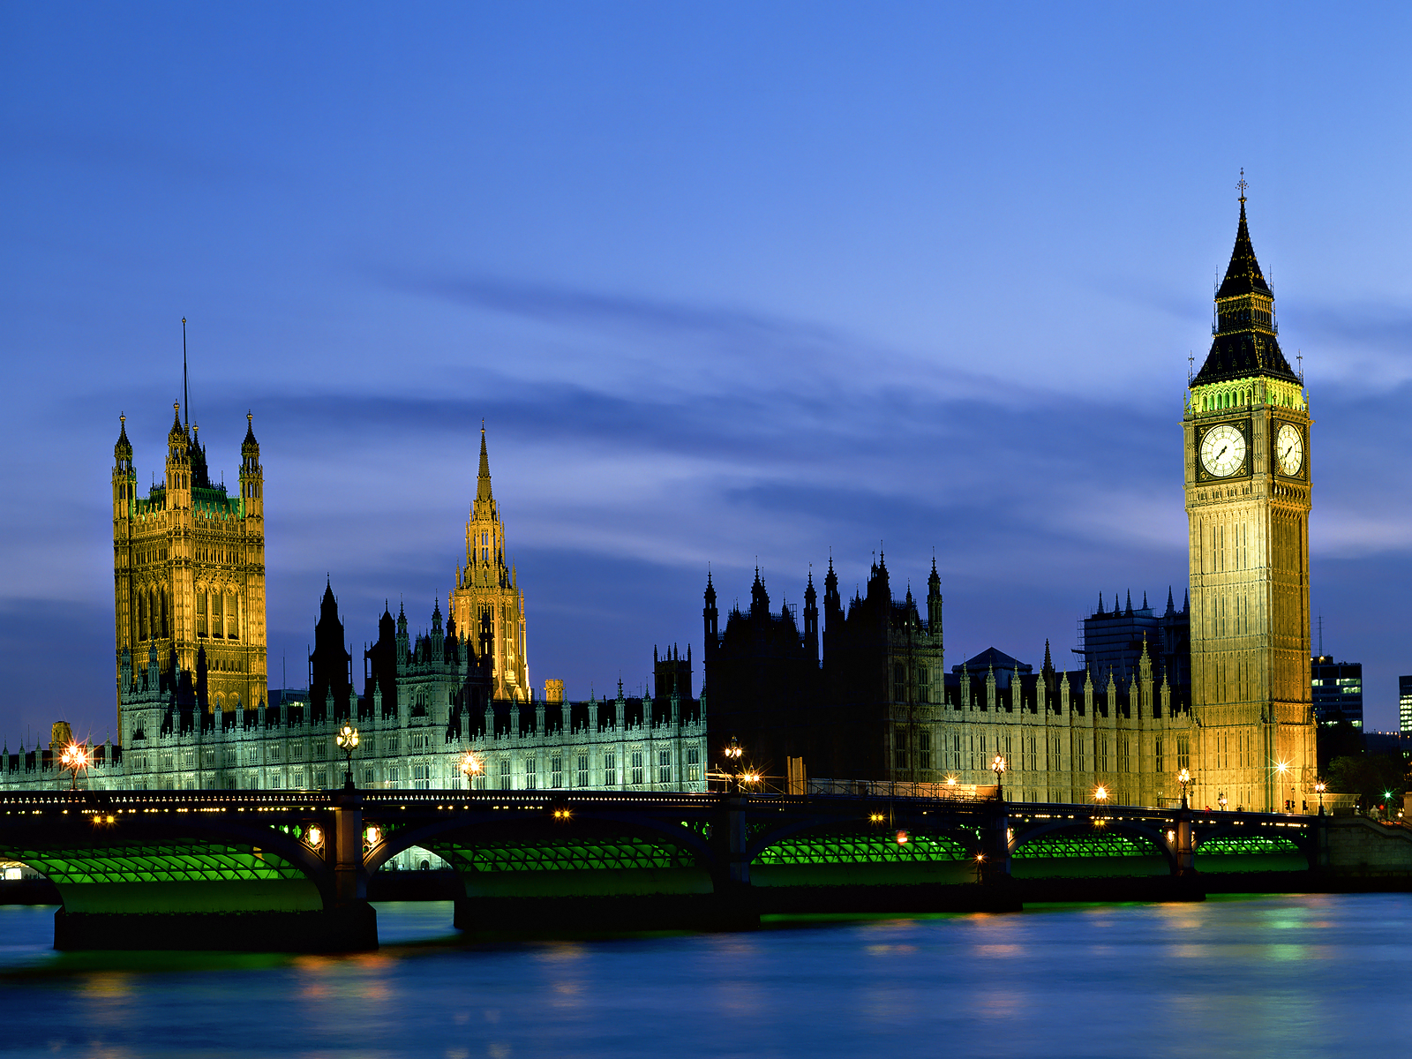
William Blake
Born in 1757 in London, England
English poet, painter, and engraver
Considered one of the best artists of his time
Rejected ideas of Catholicism, as well as all
organized religion
Part of the Romantic Movement in Europe
Influenced by Chaucer and Mary Wollstonecraft
Works relatively unrecognized during his life
Died 1827

Slide 3


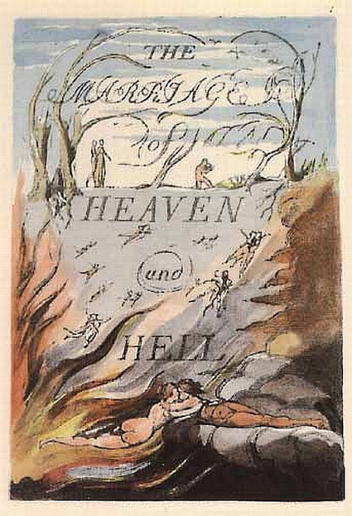
William Blake “Proverbs of Hell”
Influences
Book of proverbs of the Old Testament
Serves as a parody by being opposite
The book of proverbs instructs how to be wise not foolish while Blake’s “Proverbs of Hell” instruct essentially how to get into trouble.
For Example
A dead body revenges not injuries. ~Blake
The wicked is banished in his wickedness, But the righteous has a refuge in his death. Proverbs 14:32
If the fool persists in his folly, he will become wise. ~Blake
Do not answer a fool according to his folly, Lest you also be like him. Proverbs 26:4

Slide 4



Proverbs of Poly

Slide 5
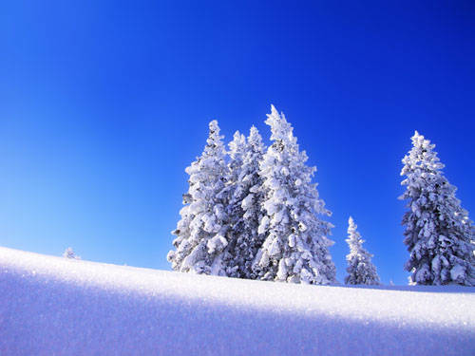
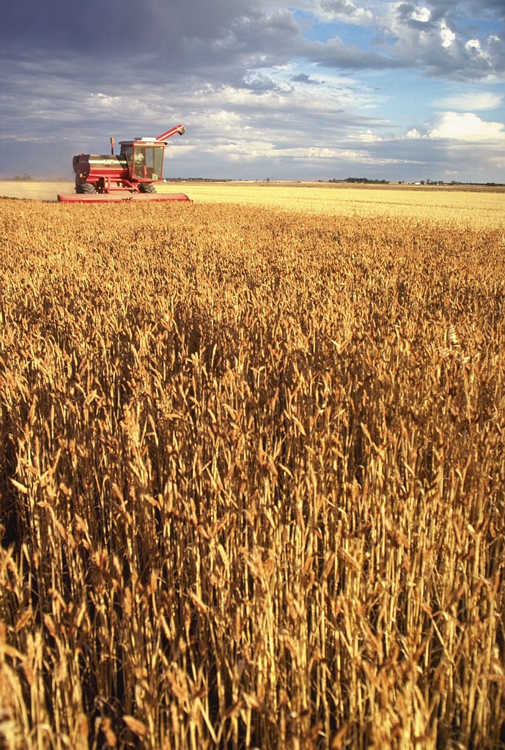
In seed time learn, in harvest teach, in winter enjoy

Slide 6

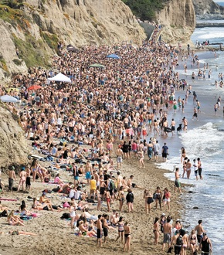
In fall quarter and winter quarter learn, in spring quarter give yourself 12 units and enjoy

Slide 7
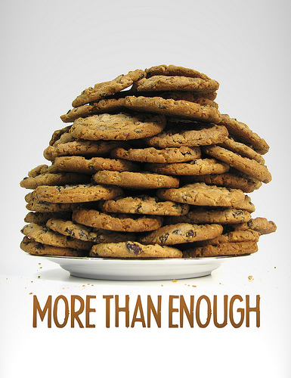

You never know what is enough unless
you know what is more than enough

Slide 8
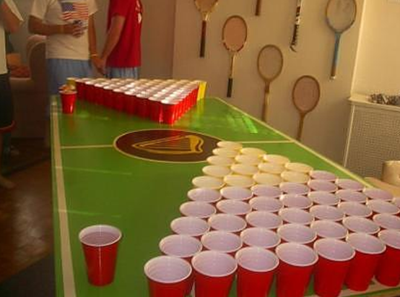
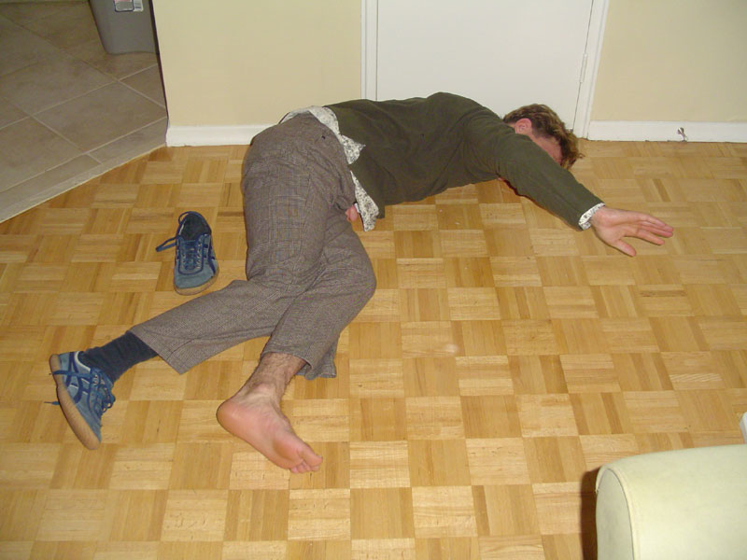
You never know what is enough unless you know what is more than enough

Slide 9
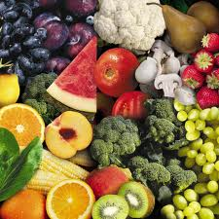
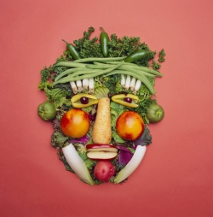
All wholesome food is caught without a net or trap

Slide 10
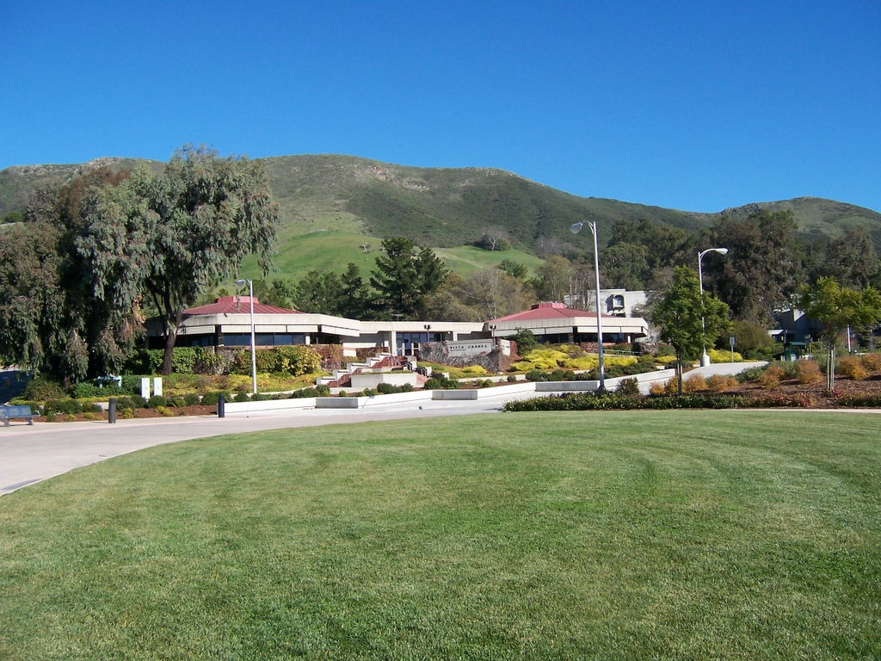
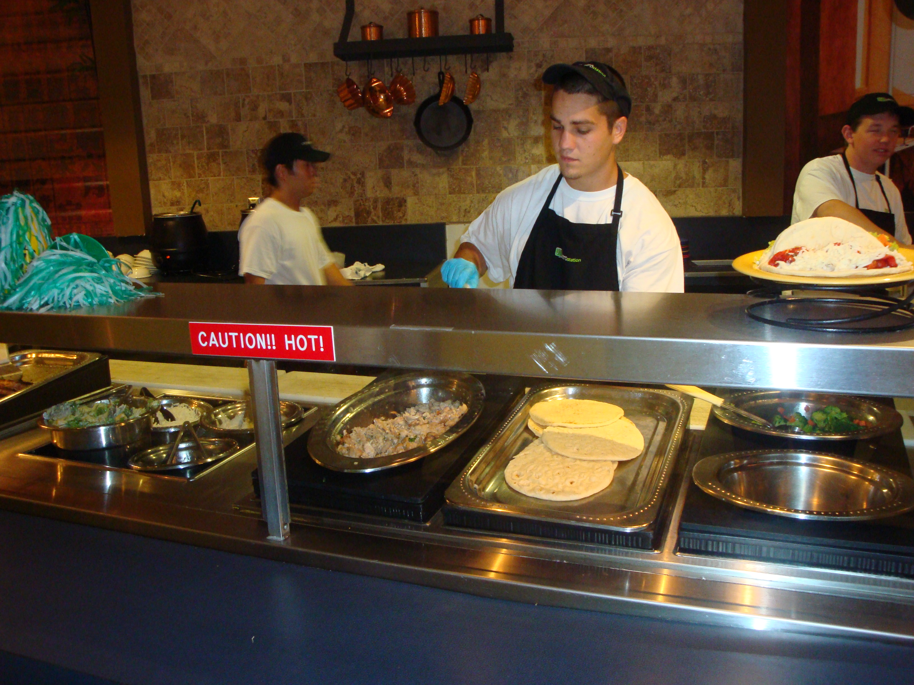
All wholesome food is not caught, trapped, or made by Metro or VG’s

Slide 11
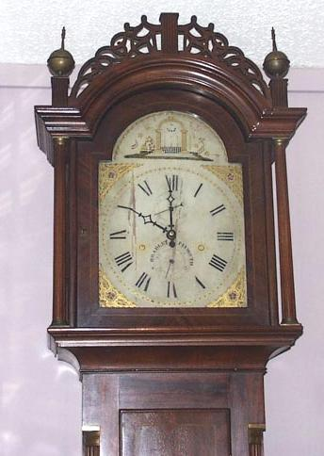
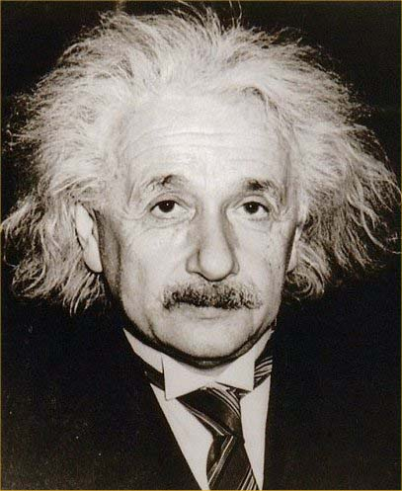
The hours of folly are measured by the clock, but of wisdom no clock can measure.

Slide 12


The hours spent on Facebook are measured by the clock, but hours of study are measured by grades.

Slide 13
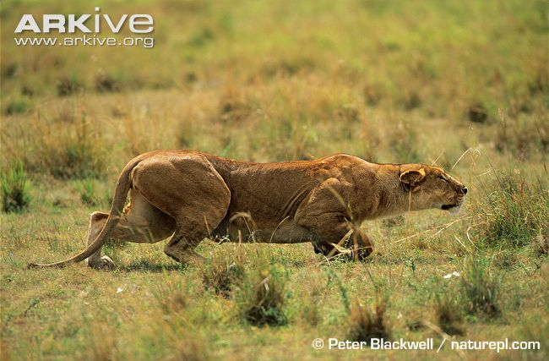
The weak in courage is strong in cunning.

Slide 14
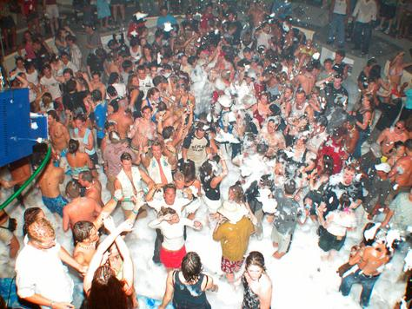
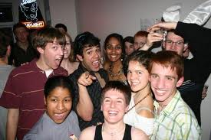
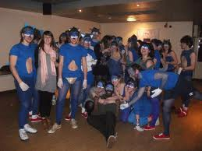
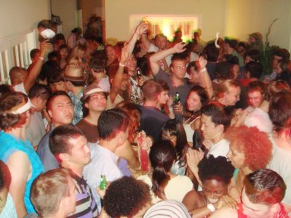
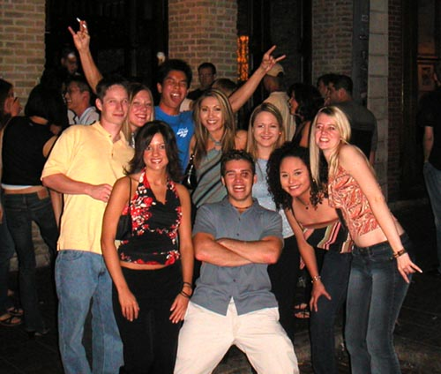
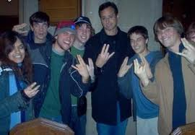
The weak in studies are strong in friends.

Slide 15

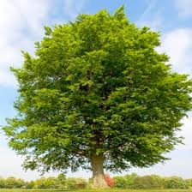
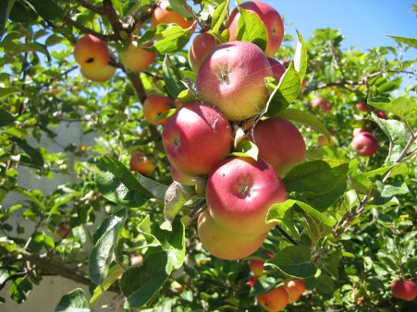
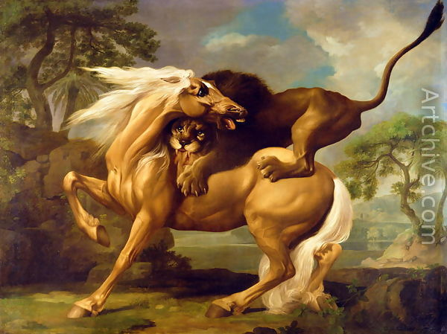
The apple tree never asks the beech how he shall grow, nor the lion, the horse, how he shall take his prey.

Slide 16

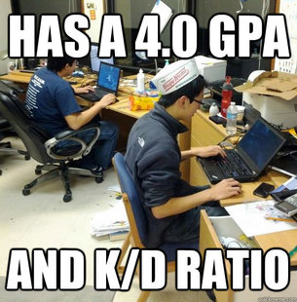
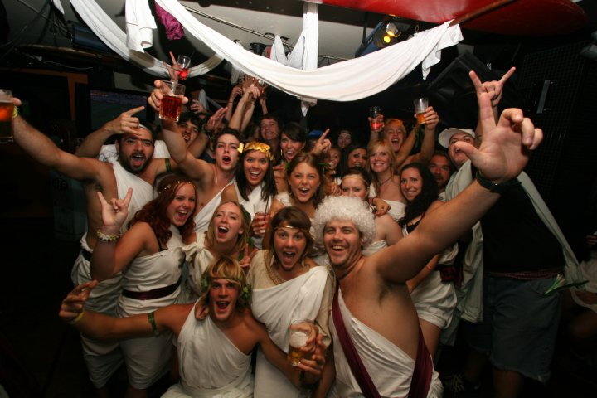
The engineer never asks the business major for help with calc, nor the business major, the engineer, how to make friends.

Slide 17
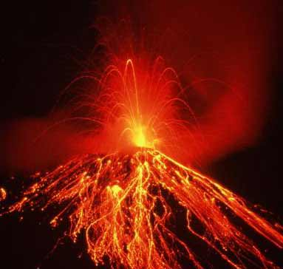
The ancient tradition that the world will be consumed in fire at the end of six thousand years is true, as I have heard from Hell.

Slide 18

The standard tradition that a degree will be earned in four years is false, as I have heard from the office of the registrar who have seemingly decided to open enough sections for about ten people to get twelve units.
Something…

Slide 19
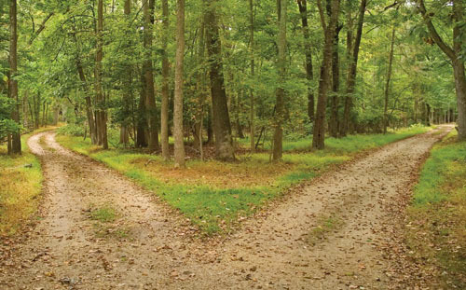
Two roads diverged in a construction area, and I took the one less traveled by. I got to class at basically the same time.

Slide 20


If time to study is bounding, so then is time for COD.

Slide 21
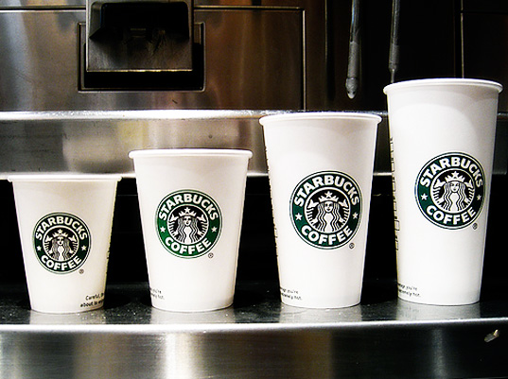
Sleep…
Sleep is an optional phenomenon
…is an optional phenomenon

Slide 22
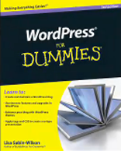
Study or don’t study. Either way, you're winging it at crunch time.
Winging It

Slide 23
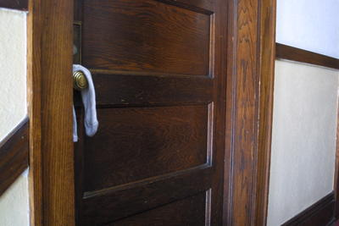
A locked door is barrier to sight, not sound.

Slide 24
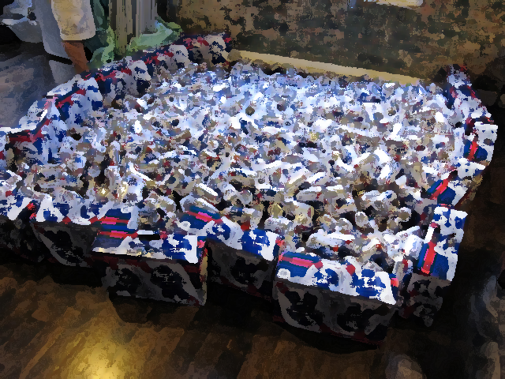
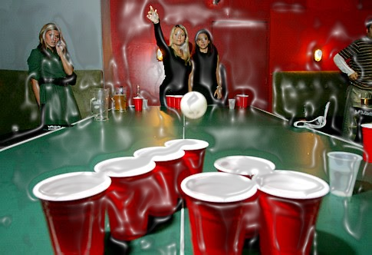
We are hope, the heralds of tomorrow, let us celebrate!

